Slide 1

Comic Strip
Conversations
When?
After a specific situation
Before a specific situation
Why?
To explore a situation
To explore consequences
To explain what other people…
- do
want
- feel
- think
Where?
In school
At home
Who?
For pupils with emotional- social difficulties
For pupils who struggle with more abstract language
For students who need to ‘vent’
Drawn with Staff / Parents
Drawn by pupil / adults
What?
A comic strip
About a specific situation
Showing different emotional reactions, thought and speech bubbles
Moving from description to perception.

Slide 2
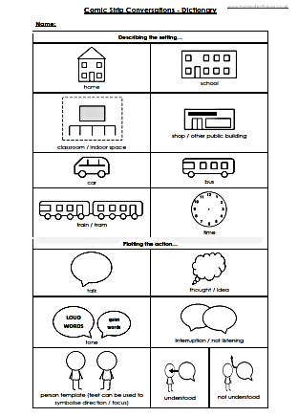
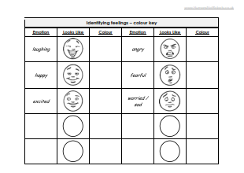
‘Comic Strip Conversations’
Take a past or future event.
Ask the student to describe it in their own words.
You could also use any reports / statements from other people involved.
Break the situation down into around 6 – 8 stages.
Draw pictures that show what happened including anything that was said.
From there – working with the student but as a mentor rather than equal partner - colour code what was said according to emotions.
From there, add any possible thoughts
Notes:
2

Slide 3
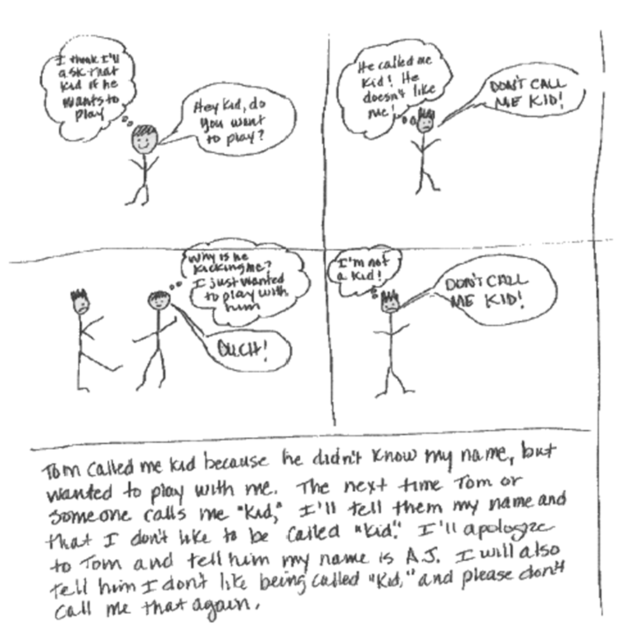
Responsive - To reflect on a situation, to restore a relationship…

Slide 4
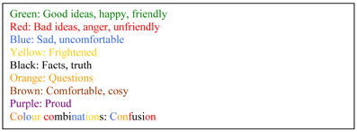
Typical Colour Coding…

Slide 5
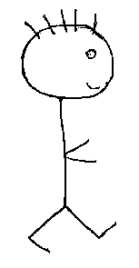
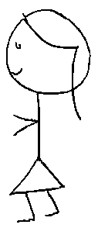
Responsive - To reflect on a situation, to restore a relationship…
Like Tim but Sometimes he follows me around too much. I want to speak to other people. I need to tell him.
Hi Jane, shall we play another game of cards.
I really like Jane. I want her to go to the cinema with me
Hi, yes that would be fun.
I want to spend more time with Jane…
Will you come round to my house?
Stop stalking me!
Help! He’s asked this very suddenly. I don’t know him.

Slide 6
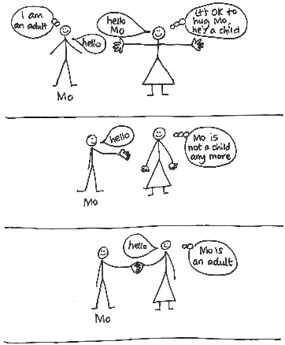
Pro-active – to talk through a change…

Slide 7
Situation:
William was asked by his music teacher to take a drum to the other music classroom.
On his way down the corridor he met Joe. Joe was on his way to get a replacement lunch ticket. It is period 4 and lunch takes place next. Joe usually gets on OK with William. They have known each other since primary school.
William blocked Joe’s way and started banging the drum. Joe became angry and tried to snatch the drum off him.
This disrupted the Mr Smith’s drama lesson. Mr Smith gave both boys a detention.
William is very upset at the detention because he insists it was a joke. He is adamant he won’t be doing it. William is also fearful Joe will target him – he blames Joe for the incident.

Slide 8
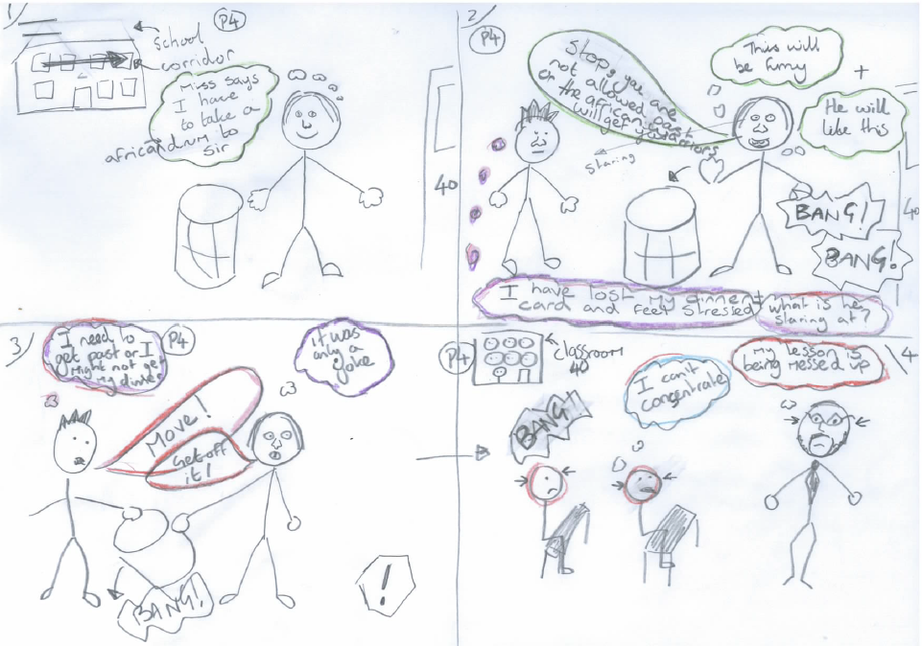
‘Comic Strip Conversations’
Notes:
8

Slide 9
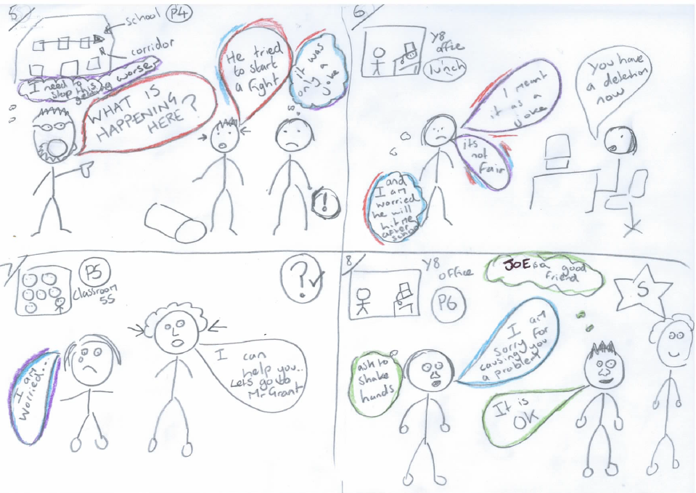
‘Comic Strip Conversations’
Notes:
www.HumansNotRobots.co.uk
9

